Slide 1
DataFirst Fall 2023 Projects
Plenary project presentations
18 projects
About 3 minutes each (+1 minute for any plenary questions)
To be followed by:
Breakout sessions
Opportunity to further explore projects with mentors
For mentors attending in person or on Zoom
Alternative: DataFirst Piazza (see DataFirst website)
USC DataFirst Fall 2023

Slide 2
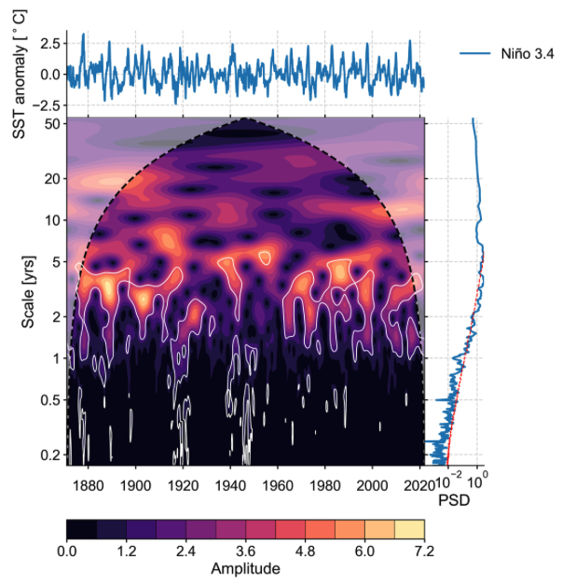
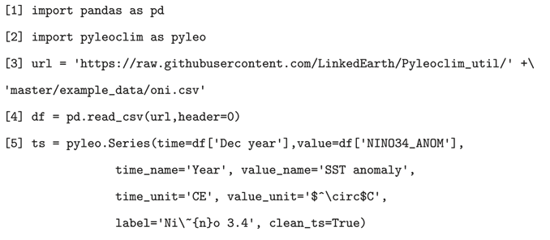
Pyleoclim: A Python Package for the Analysis of Paleoclimate Data
Prof. Deborah Khider and Prof. Julien Emile-Geay
Why Paleoclimate?
A sleek interface
- Understand how climate has changed in the past so we can put the current changes into context.
What is Pyleoclim?
- Python Package for the analysis of paleoclimate time series data
- Automate data transformation
- Automate visualization
USC DataFirst Fall 2023
https://pyleoclim-util.readthedocs.io/en/latest/

Slide 3
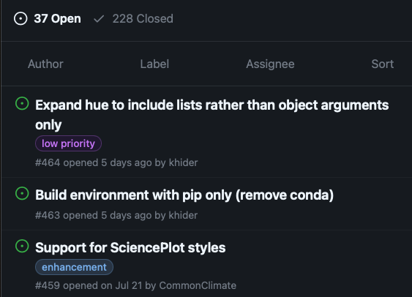
Pyleoclim: A Python Package for the Analysis of Paleoclimate Data
Prof. Deborah Khider and Prof. Julien Emile-Geay
We have feature requests!
How can you help?
Skills needed
- Visualization, data validation, outlier detection, fluctuation analysis.
Depends on issue
Basic: Python, NumPy, Matplotlib
Advanced: unsupervised learning, scikit-learn, seaborn, pandas
Set your time commitment!
Pick your issue based on interest, skills, and time
Work on your issue in a Notebook
Integrate your functionality into Pyleoclim
Write CI tests
Write Documentation
Write a Tutorial Notebook to teach scientists about your functionality!
What you will learn
Timeseries analysis, code packaging, project management, GitHub, containerization, building tutorials and documentation, JupyterBook, open source development
http://linked.earth/PyleoTutorials/intro.html
khider@usc.edu; julieneg@usc.edu
USC DataFirst Fall 2023

Slide 4
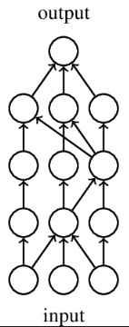
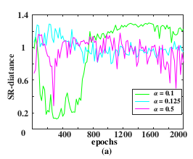
Learning and forgetting in neural networks Prof. Marcin Abram
Task: You will study mechanism responsible for learning and forgetting in artificial neural networks.
Approach: You will investigate neuron activation patterns emerging under different conditions (e.g. when learning examples from different data distributions).
Personal Goal: You will learn how the information is acquired by and stored in neural networks.
Scientific Goal: You will explore connections between machine learning and physics (a sign of potential phase transition).
Skills needed: Python, TensorFlow or PyTorch
USC DataFirst Fall 2023

Slide 5
Utilizing AI Generated Images for Object Detection and Classification Prof. Seon Ho Kim
Description: Developing image-based object detection and classification models requires significant time, resources, and effort. Especially, acquiring a good training dataset is essential. However, there are some cases when it is very hard to get quality data such as rare cases (e.g., disasters) or expensive cases to get (e.g., faraway places). Due to the development of generative AI, we might produce synthetic images to enhance the quality of dataset by filling up missing images with them. Based on our prior work in object detection and classification for smart city applications, we would like to explore the potential of AI generated images for an enhanced object detection and classification.
Skills needed: Python, Some knowledge in image machine learning, Knowing existing methods such as Yolo is desirable, Imagination!!!
Students will learn: Image machine learning, object detection applications
USC DataFirst Fall 2023

Slide 6
Urban Futures Data Core Prof. Alice Chen
Description: Cities are the focal point of economic, social, and environmental challenges and opportunities. To establish USC as a thought leader and partner of choice to tackle the challenges of the urban future, the USC Sol Price School of Public Policy and the USC Marshall School of Business propose establishing an Urban Futures Data Core to serve as a university-wide hub for data analysis and dissemination. Students working on this project will first build an algorithm that gathers information from published research papers by Price and Marshall faculty. Information collected include dataset name, availability, and geographic level of granularity. Students will also have the opportunity to interview faculty to understand data use agreements. Next, they will build and design a website to present a detailed data catalogue that can be updated in real-time. Finally, students will have the opportunity to use the data to create geographic visualizations of key indices related to urban futures.
Skills needed: Python; web design, web scraping
Students will learn: The students will learn about all data sources used in public policy and business, data management, and web design.
USC DataFirst Fall 2023

Slide 7
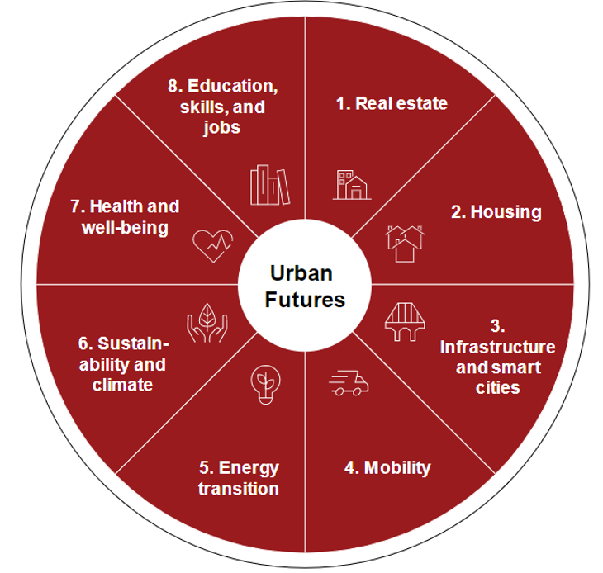
Urban Futures Data Core Prof. Alice Chen
FOCUS AREA | DATA EXAMPLES
1. Real estate | Neighborhood data for social change
2. Housing | House sale price data
3. Infrastructure | Travel diary data
4. Mobility | Cell phone data
5. Energy | Energy consumption data
6. Sustainability | CO2 emissions data
7. Health | Life expectancy, health spending data
8. Skills and jobs | Employment characteristics
USC DataFirst Fall 2023

Slide 8
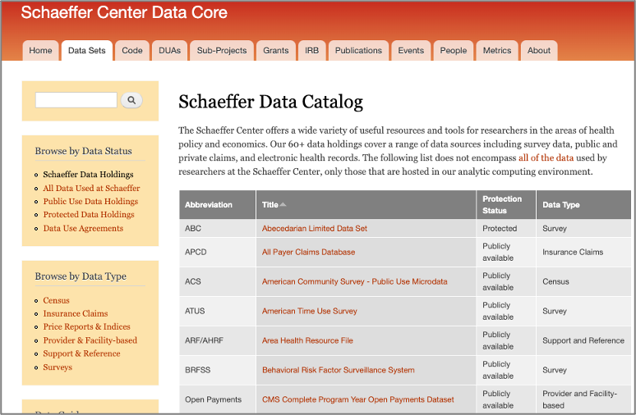
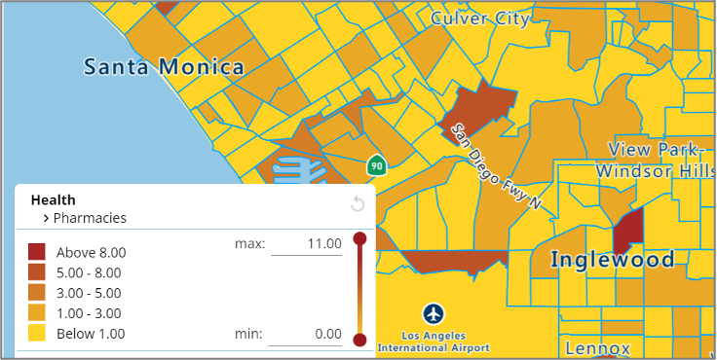
Urban Futures Data Core Prof. Alice Chen
USC DataFirst Fall 2023

Slide 9
AI/ML assisted fault detection in foundry processed devices Prof. Andrew Rittenbach and Prof. JP Walters
Description: Highly accurate fault detection in foundry produced microelectronics is crucial to ensuring quality of devices that leave the foundry. However, current defect detection flows are human-centric, which produces a bottleneck. The objective of this project is to leverage recent advances in AI/ML to develop automated techniques that can 1) identify manufacturing defects in microelectronics using imagery collected at the foundry, and 2) determine whether the identified defect will impact the performance of the manufactured component.
Skills needed: Python, PyTorch or TensorFlow, image analysis
Students will learn: Students will learn about manufacturing defect detection algorithms, machine learning techniques, and microelectronics fabrication.
USC DataFirst Fall 2023

Slide 10
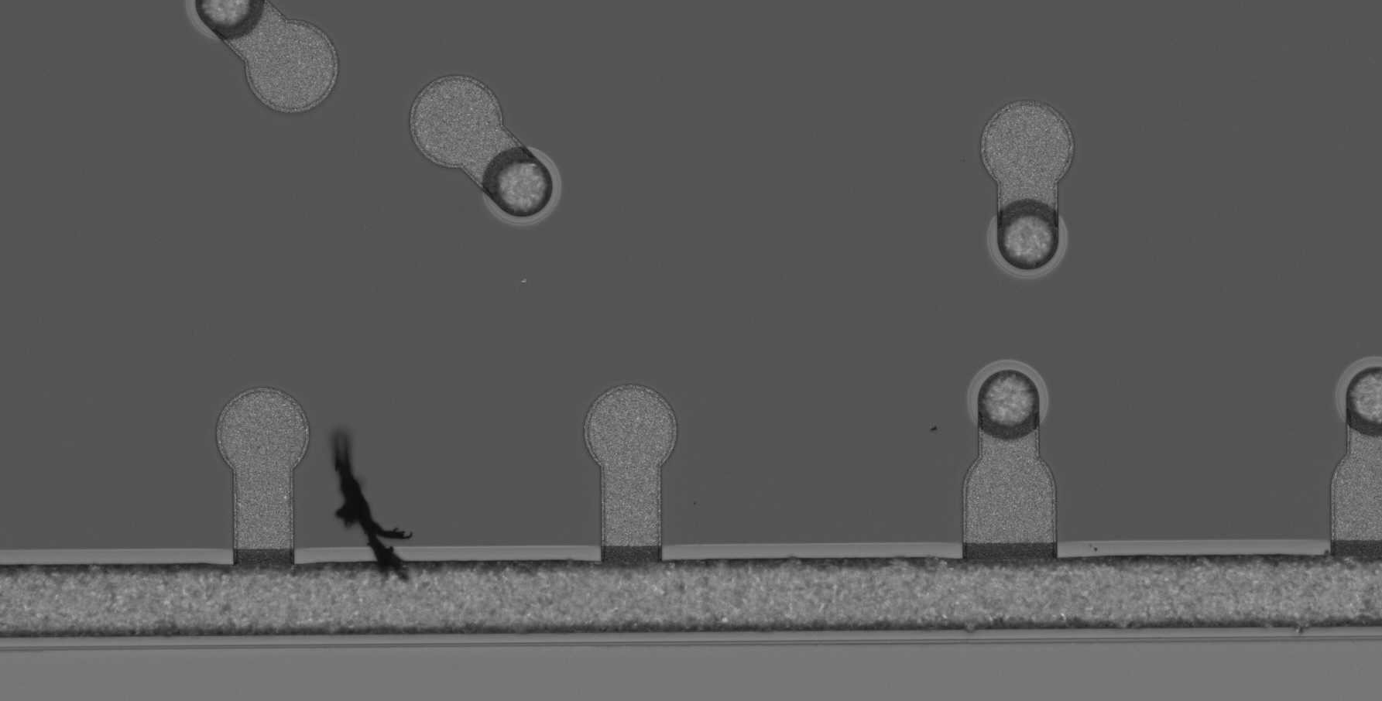
AI/ML assisted fault detection in foundry processed devices
Highly accurate fault detection in foundry produced microelectronics is crucial to ensuring quality of devices that leave the foundry
However, many current IC defect detection flows are human-centric and have potential to be a bottleneck in the foundry
Objective of this study is to find ways to leverage recent advances in AI/ML to enhance and accelerate the fault detection flow
Sample defect- foreign material in IC spanning multiple structures
Notes:
Hi, my name is Andy Rittenbach and I’d like to tell you a little bit about our project, AI/ML assisted fault detection in foundry processed devices. First, I would like to apologize for not being able to present in person. I am based out of the Arlington office of the Information Sciences Institute on the east coast, and I’m currently trying to get my four year old daughter to sleep. In this project we will be looking at ways to accelerate the defect detection flow of microelectronics produced at a foundry. Currently, most foundries use an image processing based approach that identifies potential defects in microelectronics by looking for variations in image contrast. If a chip is flagged as potentially having a defect, an engineer is brought in to look at the chip and to determine whether there actually is a defect. As you can imagine, this is a very time consuming and expensive process, and microelectronics manufacturers are looking for ways to reduce the time and costs, and to increase the accuracy of defect detection systems.

Slide 11
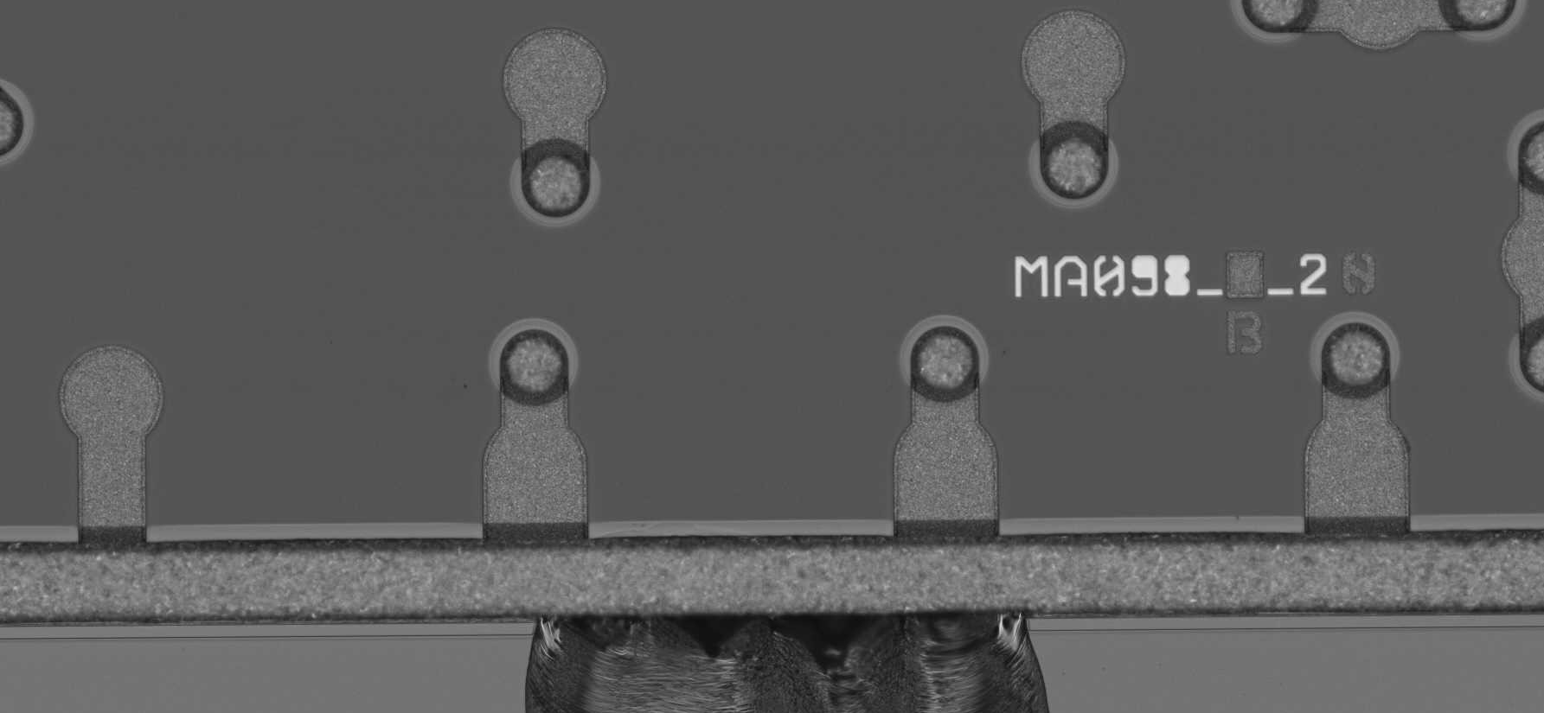
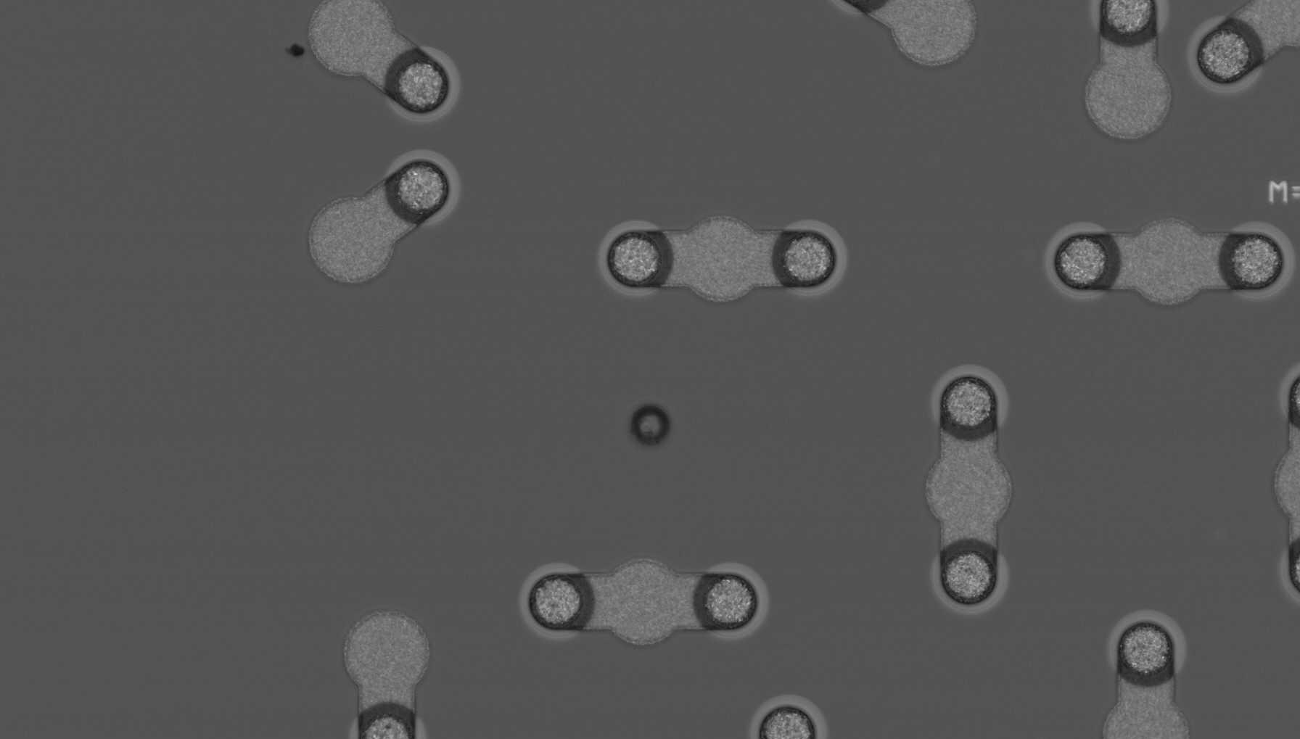
Challenge 1: Many different types of defects
Metal bridging
Foreign material
Chip out
Wafer pitting
Defects have many different shapes and sizes
Notes:
One challenge is that there are many different types of defects that can occur. I’ve highlighted a few of them here, but you can see that they all have very different shapes and sizes. Any viable defect detection model needs to be able to account for all of these types of defects, as well as many others.

Slide 12
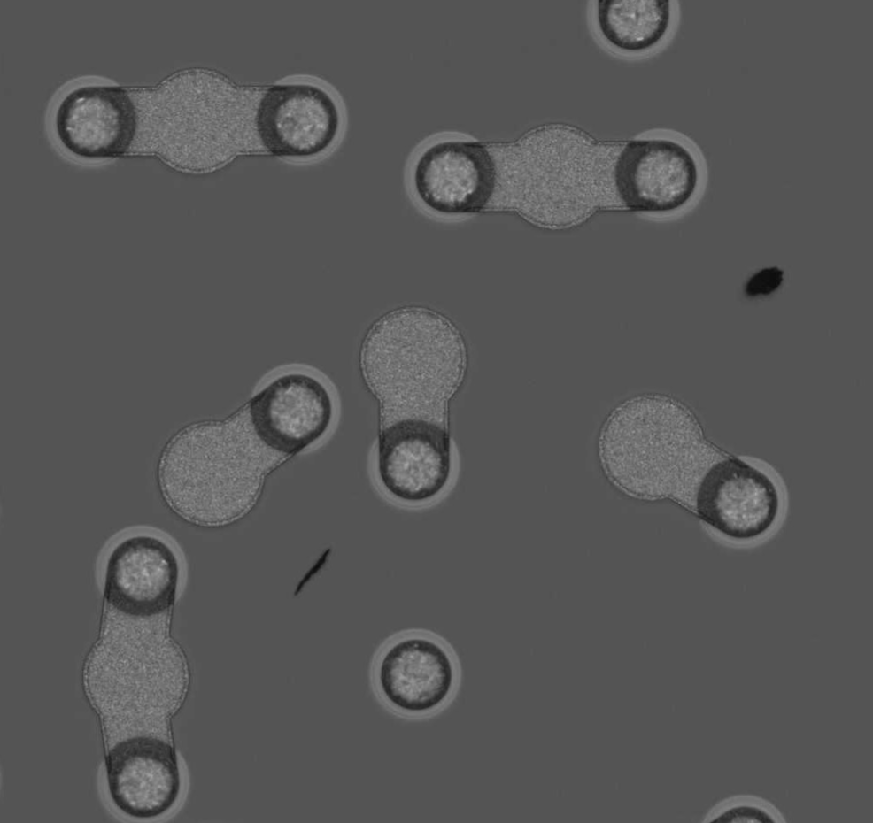
Challenge 2: Not all defects are show-stoppers
Foreign material crossing boundaries
Foreign material in IC wafer
Not all defects impact performance of IC, and some are considered acceptable
Notes:
Another challenge is that not all defects are show-stoppers. Here are two images of different chips with foreign material. In the chip on the left, the foreign material crosses multiple boundaries, which means that the chip must be discarded. However, the chip on the right has two pieces of foreign material that is only in the wafer of the chip. This is considered an acceptable defect, and the chip can still be used. Our defect detection approach needs to be able to take this feature of defects into account as well. Ideally, at the end of the project, we'll have a model that identifies chips as either defect free, having an acceptable defect, or having a rejectable defect.

Slide 13
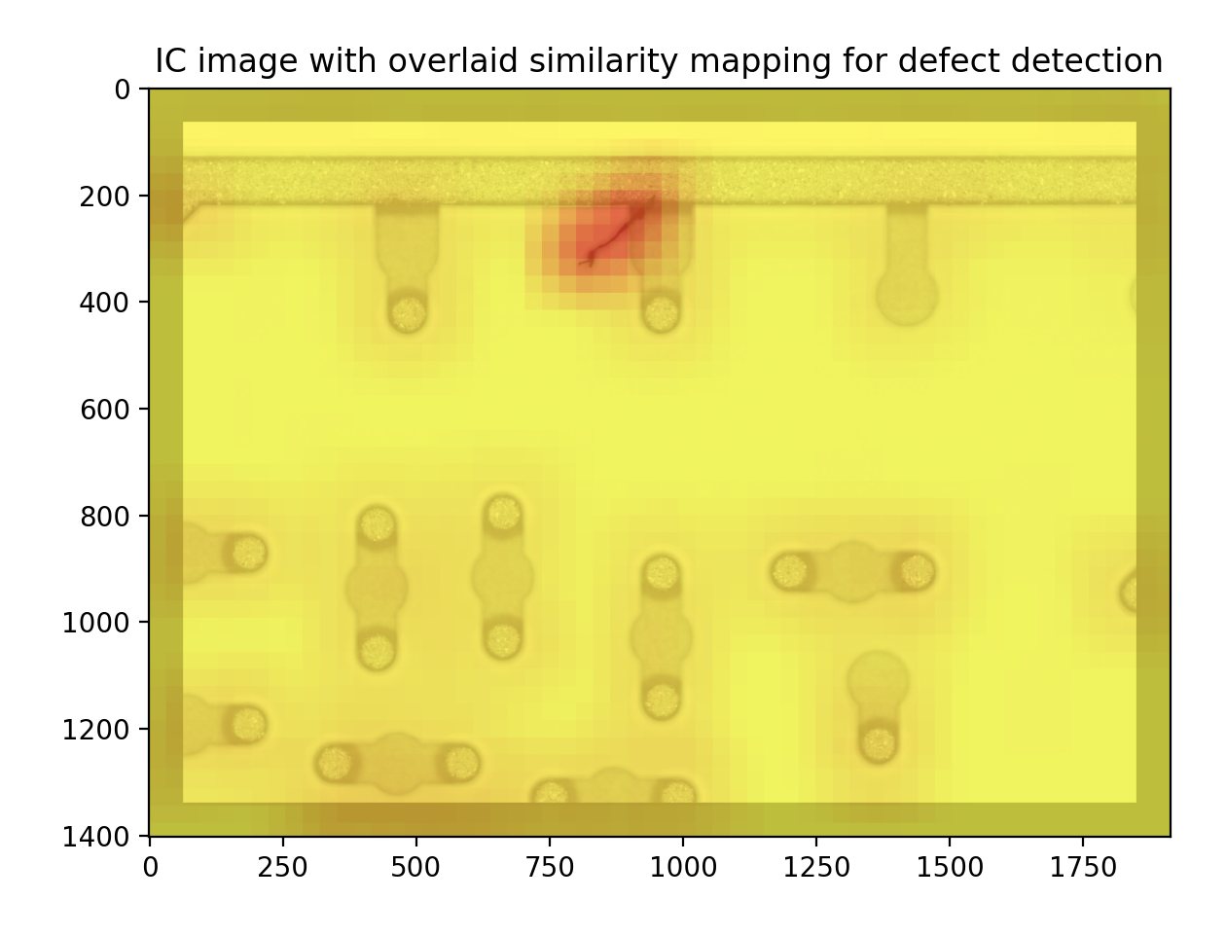
Project objectives
Due to large variety of types of defects, training a model to identify defects using a completely supervised based approach is not viable
Difficult to collect large training corpus with many samples of each type of defect
Want model to be able to identify when IC has a defect even when defect example was not included in data used to train model
Better approach is to train model that learns what IC should look like, and to recognize when there is a defect
Involves development of anomaly detection models
Stretch goal is to find a solution that makes use of pretrained feature extractors
Sample similarity mapping generated using deep image embeddings for defect detection
Notes:
Because there are so many different types of defects, a supervised approach where a model is trained using examples of each type of defect is not viable. This is because it is very difficult for the manufacturers at the microelectronics foundry to collect sufficient data samples of each type of defect. Our contact at the foundry told us that she has a book listing over 250 types of manufacturing defects, and there are many that she has never seen, so we’ll be working with an incomplete dataset for this project. Because of this, we need our model to be able to identify defects, even if the defect was not included in data used in our training dataset. Our goal for this project is to develop a model that learns what an integrated circuit should like, and to use this information to recognize when there is a defect. This is typically known as an anomaly detection problem. We’re also really interested in finding a solution that makes use entirely of pretrained feature extractors. For example, the heatmap shown on the right was generated through the use of deep image embeddings from a pretrained convolutional neural network followed by image similarity search.

Slide 14
Thank you!
If there are any questions, or if you have further interest, please reach out to:
Andy Rittenbach: arittenb@isi.edu
JP Walters: jwalters@isi.edu
Notes:
Thank you for your time, if you have any questions please feel free to reach out to me through my email or through the project Piazza page, and I’ll be happy to answer them. Thanks again.

Slide 15
California Public Sector (CAPS) Job Market: Online Dashboard Prof. William Resh (Civic Leadership Education and Research (CLEAR) Initiative)
Description: Public sector institutions at local, state, and federal levels are facing an unprecedented hiring crisis in competition for new talent. Yet there is no systematic understanding of the needs and openings across these levels of government to inform stakeholders such as universities, community colleges, and high schools on the current and emerging hiring trends in what constitutes approximately 15-20% of the entire labor market. In this project, students will develop algorithms that continuously scrap relevant job sites used by these governments to assess both developed and emerging hiring trends by aptitudes, professions, entry-levels, mobility, location, and other important attributes. In so doing, the project will inform researchers in public policy, public administration, political science, and labor economics as well as practitioners in government and associated stakeholders.
Skills needed: Python, Statistics, R or Stata, Web Development
Students will learn: Students will learn how to develop and organize labor market data to be used by practitioners and researchers through the construction of portal that can ably transform data into usable aggregated statistics and graphs.
USC DataFirst Fall 2023

Slide 16
California Public Sector (CAPS) Job Market: Online Dashboard Prof. William Resh (Civic Leadership Education and Research (CLEAR) Initiative)

Slide 17
California Public Sector (CAPS) Job Market: Online Dashboard Prof. William Resh (Civic Leadership Education and Research (CLEAR) Initiative)

Slide 18
California Public Sector (CAPS) Job Market: Online Dashboard Prof. William Resh (Civic Leadership Education and Research (CLEAR) Initiative)

Slide 19
A Knowledge Graph of a Crowdsourcing Event Prof. Daniel O'Leary
Description: Build a knowledge graph of a crowdsourcing event.
Skills needed: NEO4j, or Python
Students will learn: Crowdsourcing, knowledge graphs and text analysis
Mentor bio: Prof. O'Leary is Professor of Accounting in the USC Marshall School of Business, focusing on artificial intelligence, emerging technologies and text mining.
USC DataFirst Fall 2023

Slide 20
Does Municipal Broadband Deliver as Promised? Prof. Hernan Galperin
An examination of broadband pricing and household adoption in areas served by muni networks.
Description:
Broadband networks owned and/or operated by local governments ("muni networks") are increasingly seen as a key tool to close the digital divide in Internet availability and adoption.
Only anecdotal evidence about whether muni networks deliver more affordable broadband in communities of limited interest to traditional ISPs - typically disadvantaged communities.
Goal: to examine broadband pricing and adoption at the address level in areas served by muni networks, using a matched sample of comparable areas as a reference point.
The project builds on Datafest 2022 project (25K addresses in LA).
Skills needed: Data scraping (Python), statistics and basic GIS skills
Students will learn: Students will have the opportunity to apply data scraping, organization and analysis skills in the context of policy analysis
USC DataFirst Fall 2023

Slide 21
Automated question type coding of forensic interviews
Prof. Thomas D. Lyon
Question type coding is a method to assess the quality of forensic interviews
Is this question neutral or leading? Can it be answered by a simple yes or no or is it seeking to elicit more details
When the interviewees are children, such as in cases physical or sexual abuse, question type is particularly important
Will a 5 year old understand this question?
Most research in the field relies on manual question type coding
One coder codes every question in the interview, and another coder reliability codes a subsample→ Labour-intensive and time-consuming
Our goal: Develop automated question type coding for forensic interviews with children
USC DataFirst Fall 2023

Slide 22
Automated question type coding of forensic interviews
Prof. Thomas D. Lyon
The project so far
Working with a graduate of the Masters in Computer Science program
Various Large Language Models have been tried - RoBERTa performed the best
Currently integrating the large language model into Google Sheets to allow for automatic calculations of the quality of the interview
Next steps
Train the model to make finer distinctions -
Explore zero shot and few shot prompting to make distinctions for which there is limited manually-coded data
What we need
Python libraries (preferred)- pandas, huggingface, pytorch OR any coding language
What you’ll learn
Data preprocessing
Finetuning large language models
Finding optimal hyperparameter using cross validation techniques
How to deploy the fine-tuned model on a cloud platform
Research on zero shot approaches and evaluate its performance with the fine-tuned models
USC DataFirst Fall 2023

Slide 23
Building a Platform for NFL Data Insights Prof. Jeremy Abramson
Description: Open source sports data such as the nflverse has lead to a massive increase in public sports analytics. But it's still hard to process, subset, visualize and analyze this data. This project will build a general-purpose analysis platform and dashboard, similar to what many teams use internally. Using the nflfastr data, this platform will allow interested individuals to select the play parameters they're interested in, and will provide relevant analysis, visualization and insight. Ideally, we'll set up the dashboard on the internet, and
open source the project, allowing others to expand the available datasets, analyses and visualizations.
Skills needed: Python (pandas, streamlit, dash, etc. is a bonus!)
Students will learn: How to analyze and present insights from NFL play-by-play data
USC DataFirst Fall 2023

Slide 24
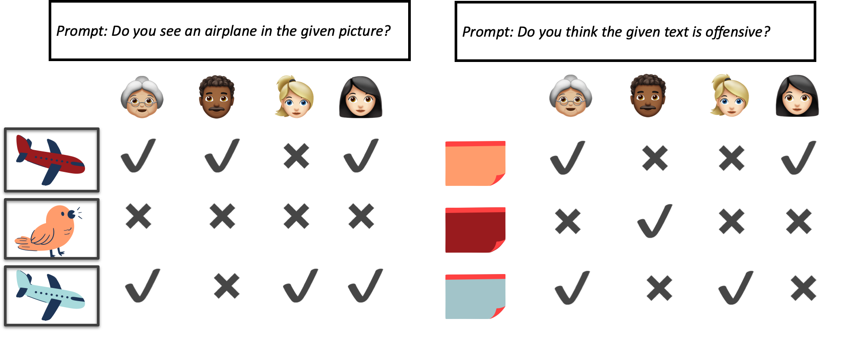
Understanding the Relation Between Noise and Bias in Annotated Datasets Negar Mokhberian
Research question: Is it possible to extract useful signal from annotators’ disagreement existing in the training data samples?
USC DataFirst Fall 2023

Slide 25
Understanding the Relation Between Noise and Bias in Annotated Datasets Negar Mokhberian
many previous work has tried to design larger and more complex neural networks.
data-centric AI has worked on shifting the focus to the quality of the train data.
Annotations are can exhibit both noise, stemming from vague instructions or human errors, and bias, arising from differing perspectives among annotators in response to given prompts.
In this project, our objective is to bridge the gap between the two lines of research: Our investigation will center on whether perspectivist classification models have effectively harnessed valuable information from instances flagged as noisy by noise-detection techniques.
What kind of classification task? We will work on the domain of offensive text detection datasets, a highly subjective task.
Skills needed: Python, PyTorch, Fine-tuning language models in Huggingface package
USC DataFirst Fall 2023

Slide 26
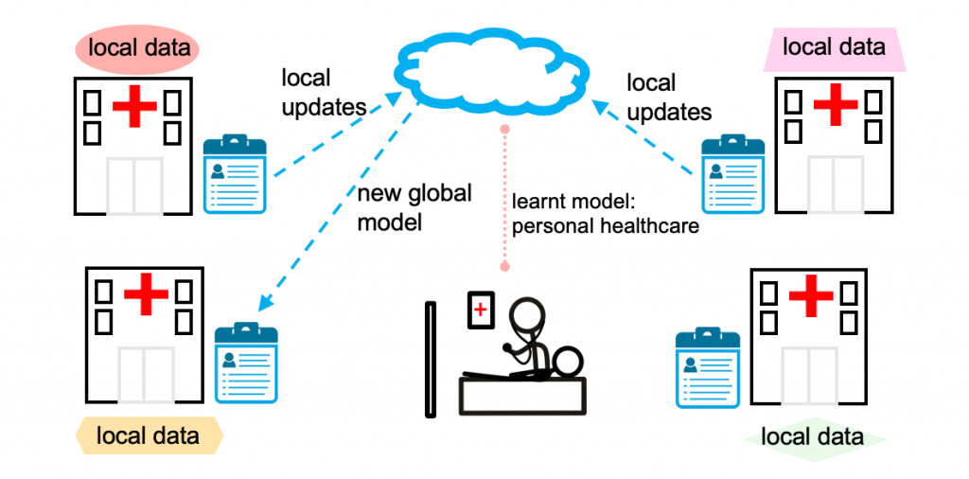
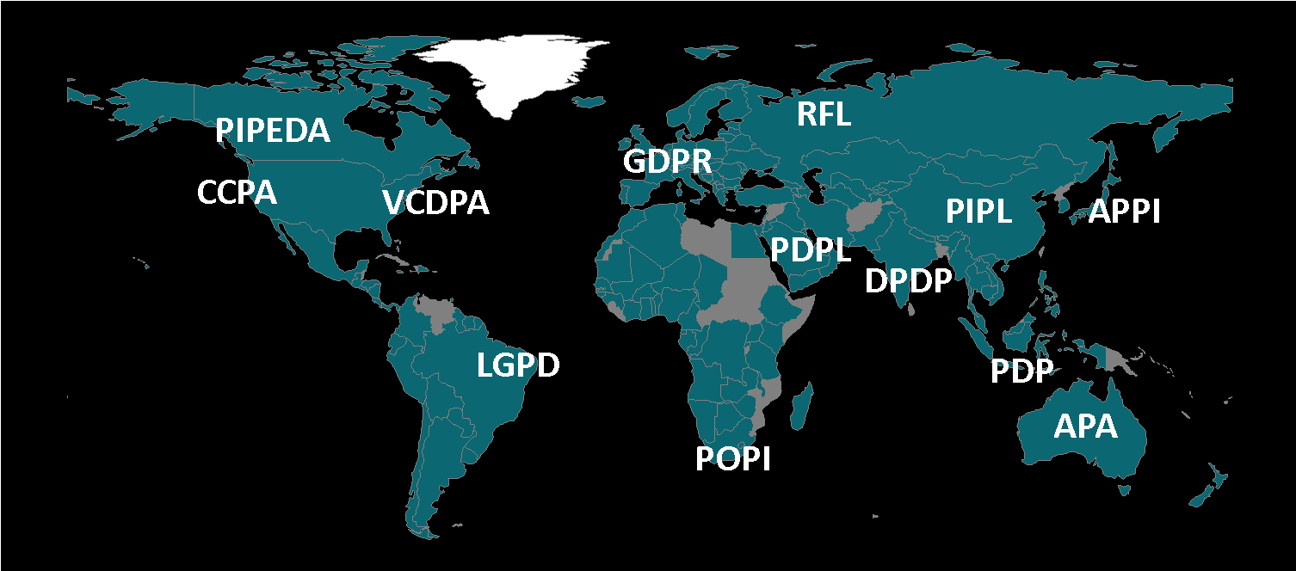
Can we learn from distributed data respecting privacy?
Learn a model over all the data without sharing data?
image courtesy: https://blog.ml.cmu.edu/2019/11/12/federated-learning-challenges-methods-and-future-directions/

Slide 27
Federated Learning: Learning without sharing data!
No data shared among data sources
Training is pushed down to data sources
Sources share parameters (e.g., weights, gradients), but parameters are strongly protected (encryption + gradient noise)
Global
Model
Local
Model
Local
Model
Local
Model
Local
Model

Slide 28
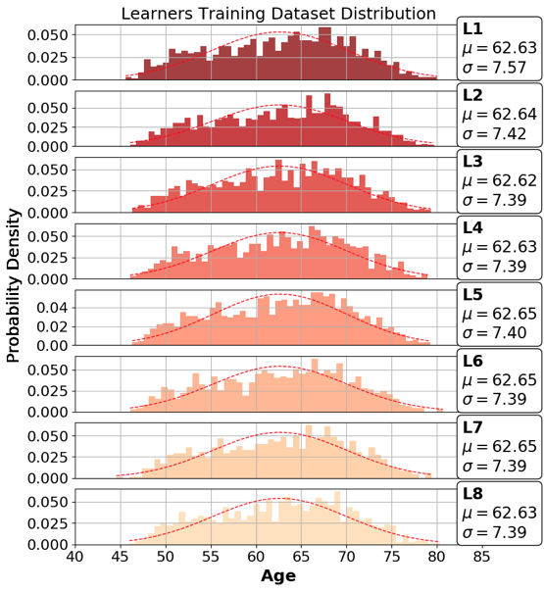
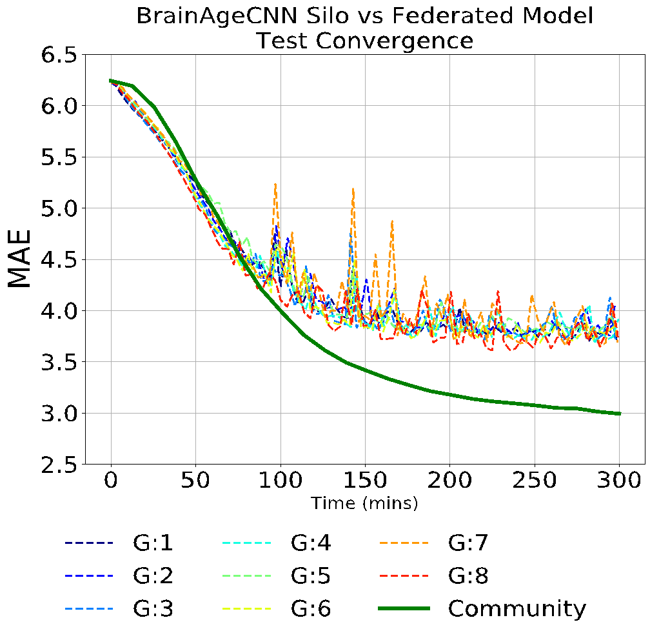
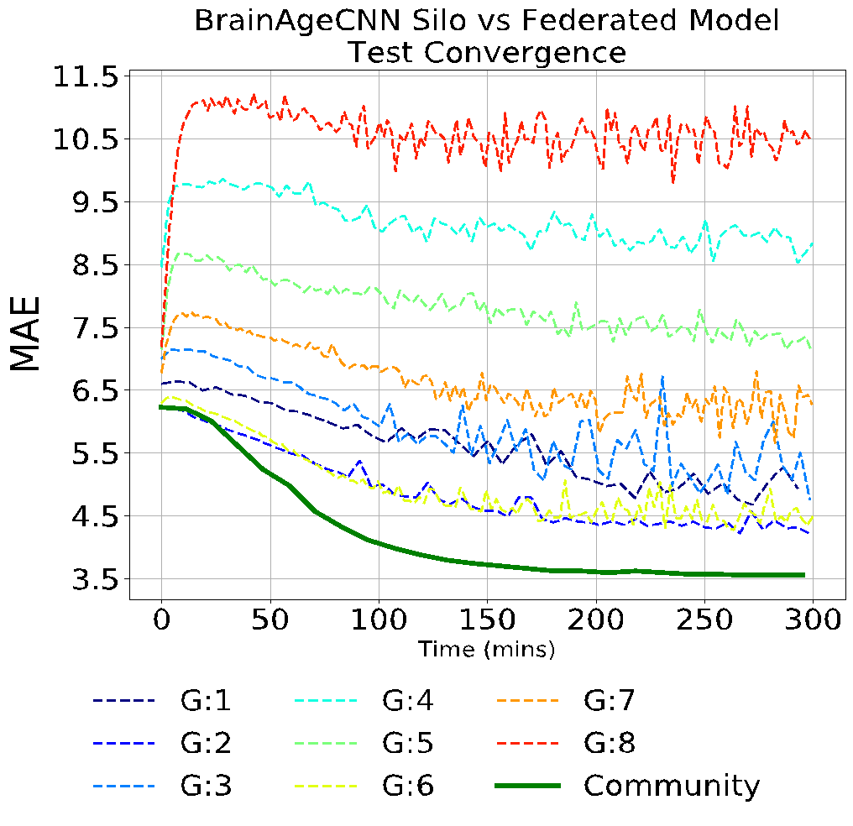
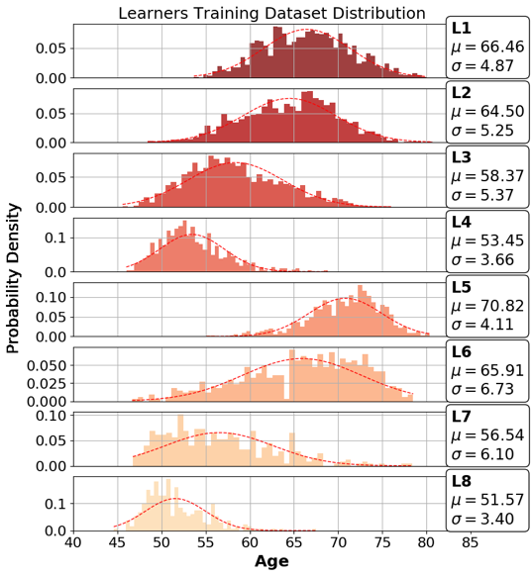
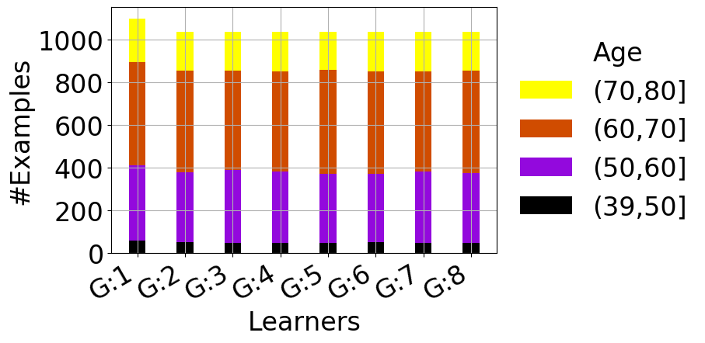
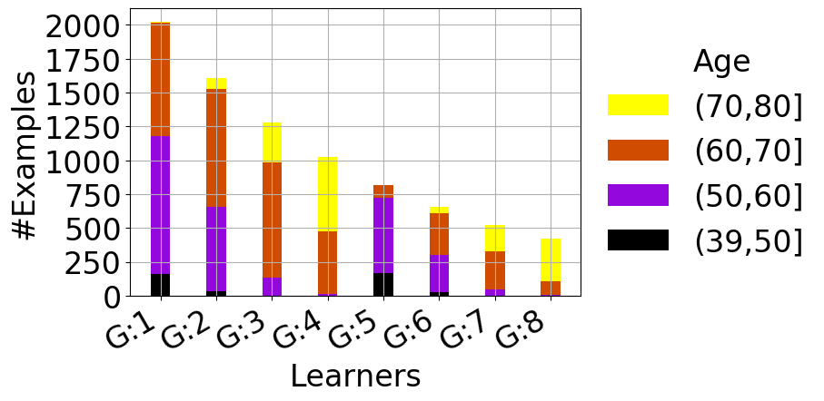
Federated Learning Outperforms any Silo
BrainAGE: predict age from MRI scan
Uniform & IID
help
Skewed & Non-IID
Silos
Silos
Federated
Federated
All sites incentivized to join the federation!
Notes:
Why we are doing FL? Because
In the more complex
Why should any site participate in a federation? Green line is a federated model that outperforms independently trained models
Teaser results! Lower MAE is better – we will explain later what each distribution is!

Slide 29
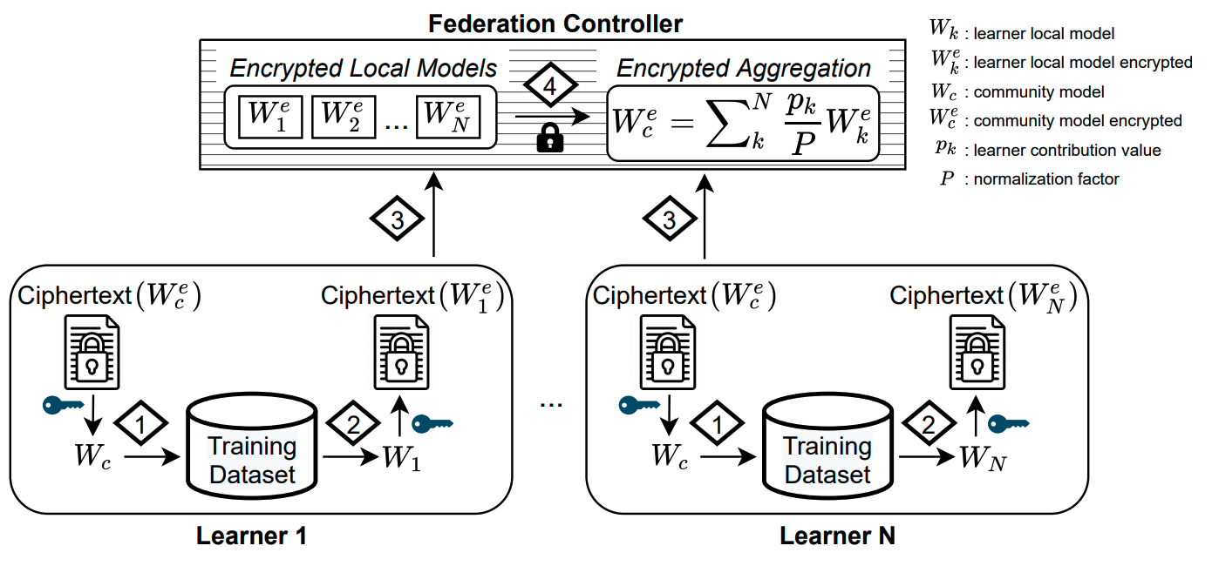
Secure Federated Learning
Encrypted
Model Aggregation
Encrypted Transmission
(of model parameters)
Data never leave sites

Slide 30
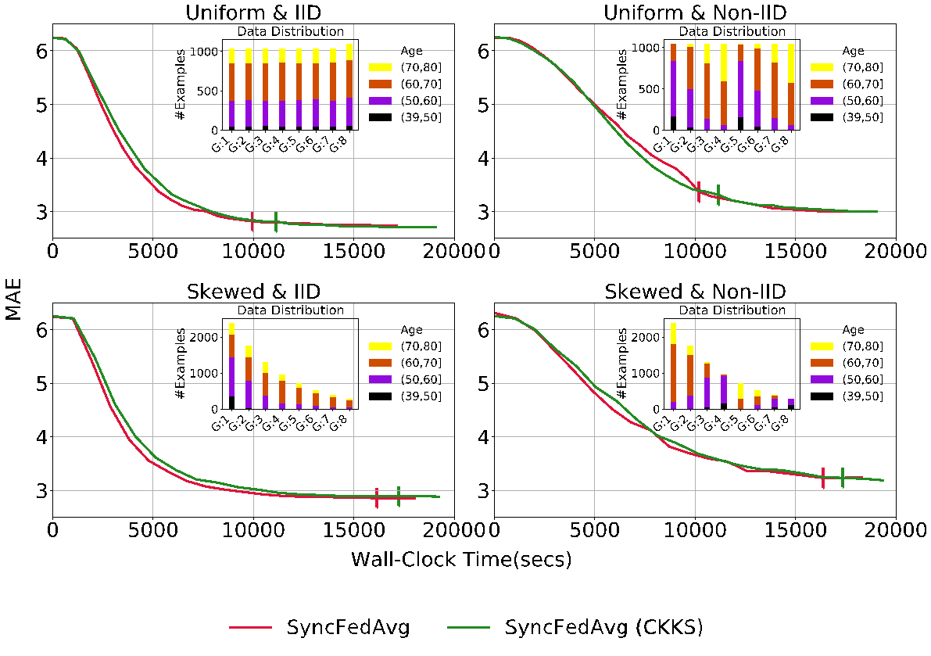
Secure Aggregation with Fully Homomorphic Encryption
BrainAGE (3D-CNN)
Federated Training with Fully Homomorphic Encryption (FHE) learns model with same learning performance
CKKS FHE (Optimized)
Low overhead (~7%)
*
*
*
*
* Vertical bars are time to complete 20 federation rounds.
Stripelis, Gupta, Saleem, Dhinagar, Ghai, Sanchez, Anastasiou, Asghar, Steeg, Ravi, Naveed, Thompson, Ambite, 2022. Secure Federated Learning for Neuroimaging. arXiv:2205.05249

Slide 31
Federated Learning for Neuroscience Prof. Jose-Luis Ambite
Description: Federated learning is an approach to distributed deep learning without sharing data. Multiple site train a neural network over private data. The parameters of the neural network are shared with a federation controller, but they are encrypted before sharing. Model aggregation is performed under fully homomorphic encryption. We propose to apply federated learning to several problems in neuroscience, such as predicting Alzheimer's, Parkinson's, epilepsy, and autism, possibly over multimodal data.
Skills needed: Python, Tensorflow, deep learning
Students will learn: Federated learning, machine learning for biomedical applications.
USC DataFirst Fall 2023

Slide 32
Bad Writing is "Fine": Tuning an LLM to Suggest Improvements Prof. Benjamin Nye
Description: Prototype an approach to fine-tune a large language model (LLM) to help diagnose areas to improve a specific writing product. For example, scientific papers require consistent language but in creative writing variety matters. Proposed steps are: 1. Writing Product: Coordinate with project mentors to choose a common and important writing product, such as a position paper or an academic conference. Identify/gather a rubric and a corpus. 3. Inject Bad Writing: For each element of the rubric, develop prompts for generative AI to decrease the quality of writing based on the rubric (i.e., make it worse). This will form a training data set of the good example and version worse on certain characteristics. 4. Fine Tune: Students will be expected to attempt to fine tune an LLM (e.g., LLAMA 2) based on this synthetically generated data 5. Evaluate: Research if tuning suggests better domain-specific areas to improve. This project aligns with ongoing work with the USC Generative AI Center.
Skills needed: Python
Students will learn: Generative AI for large language models. Generating synthetic data for a rubric. Fine tuning a large language model, likely using CARC (the on campus computing cluster). Understanding intelligent tutoring system design fundamentals for modeling how experts diagnose issues from novices.
USC DataFirst Fall 2023

Slide 33
Bad Writing is "Fine": Tuning an LLM to Suggest Improvements Prof. Benjamin Nye
Good Example: Four score and seven years ago our fathers brought forth, on this continent, a new nation, conceived in Liberty, and dedicated to the proposition that all men are created equal.
Now we are engaged in a great civil war, testing whether that nation, or any nation so conceived, and so dedicated, can long endure. We are met on a great battlefield of that war. We have come to dedicate a portion of that field, as a final resting-place for those who here gave their lives, that that nation might live. It is altogether fitting and proper that we should do this.
But, in a larger sense, we can not dedicate…
Worse Example: Four score and seven years ago our fathers brought forth, on this continent, a new nation, conceived in Liberty and dedicated to the proposition that all men are created equal. Additionally, it's important to note that during that time, they were also faced with various economic challenges and social issues that shaped the early development of the nation.
Now we are engaged in a great civil war, testing whether that nation, or any nation so conceived, and so dedicated, can long endure. We are met on a great battlefield of that war. We have come to dedicate a portion of that field, as a final resting-place for those who here gave their lives, that that nation might live. It is altogether fitting and proper that we should do this.
Focus | Purpose is clear and presented to the reader Example Issue: Add additional points to the thesis statement that are not necessary to the essay
Content | Well-presented and argued; ideas are detailed, well-developed, supported with specific evidence & facts Example issue: Argument made without support by examples/evidence
(Bad Example, Rubric Issue, Text Diff)
USC DataFirst Fall 2023

Slide 34
Analyzing Open Source Software Ecosystems
Dr. Jeremy Abramson, Dr. Jim Blythe, Dr. Alexey Tregubov
Description: Open source runs a lot of the world's critical software systems, but there is much that's unknown in how maintainers, developers and other parts of the software ecosystem function. Help us analyze a large corpus of open source data — both source code and patch conversations — to better understand them! We'll study things like rise to influence, authorship styles, malware analysis, topic modeling and social network analysis!
Skills needed: Python (needed), experience with LLMs/OpenAI APIs, program analysis, C code (preferred, but not necessary!)
Students will learn: We'll touch on using LLMs to parse text messages and analyze code, graph databases, program analysis, and social network analysis among other skill
USC DataFirst Fall 2023

Slide 35
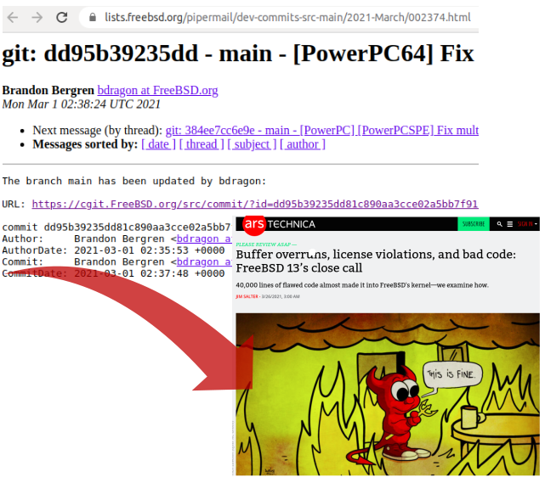
Analyzing Open Source Software (OSS) Ecosystems
Goals:
Analyze a large corpus of open source data (Linux kernel mailing list) — both source code and patch conversations — to better understand them.
Help protect the health of OSS code and communities
Project inputs:
4.2M LKML messages
Project outputs:
Extracted structured code and related patch conversations, labeled with topics, conversation summary, acceptance/rejection reasons.
High level reasoning about patch acceptance/rejection using LLM (e.g. GPT-4).
Labeled data for future projects/analysis.
Security module patch discussion bursts & author changes

Slide 36
Build a multilingual decipherment system Prof. Jonathan May
Description: We will build a working system that can decipher a letter substitution cipher into 14 languages and beyond, based on https://aclanthology.org/2021.acl-long.561/ then apply it to languages it has never seen.
Skills needed: Python, deep learning with transformers
Students will learn: read and understand an NLP paper, unusual applications of transformers, reproduction study
USC DataFirst Fall 2023

Slide 37
Natural language processing of safety reports in nuclear power plants Prof. Najmedin Meshkati
Description: Use Natural Language Processing (NLP) techniques to analyze voluminous (30K+ pages) Diablo Canyon Independent Safety Committee (DCISC) annual reports to identify the role and contribution of "Traits of a Healthy Nuclear Safety Culture", as defined by the Nuclear Regulatory Commission and the Institute of Nuclear Power Operations, in incident causation.
Skills needed: Natural Language Processing and related skills.
Students will learn: Application of NLP in real-world, working on very serious and important issues with global applications, which can be generalized and applied to other safety-sensitive technologies.
USC DataFirst Fall 2023

Slide 38
Application of AI, ML and NLP in understanding and preventing a serious aviation safety problem in the US - Runway Safety Prof. Najmedin Meshkati
Description: Use AI/ML/NLP to understand root-causes of one of the most serious aviation safety problem in the US - runway incursions. The Aviation Safety Reporting Systems (ASRS), which is administered by NASA and is an untapped treasure trove of text data, will be used for this project.
Skills needed: AI/ML/NLP and associated skills.
Students will learn: Using AI/ML/NLP and working on the data from a major global industry - aviation.
USC DataFirst Fall 2023

Slide 39
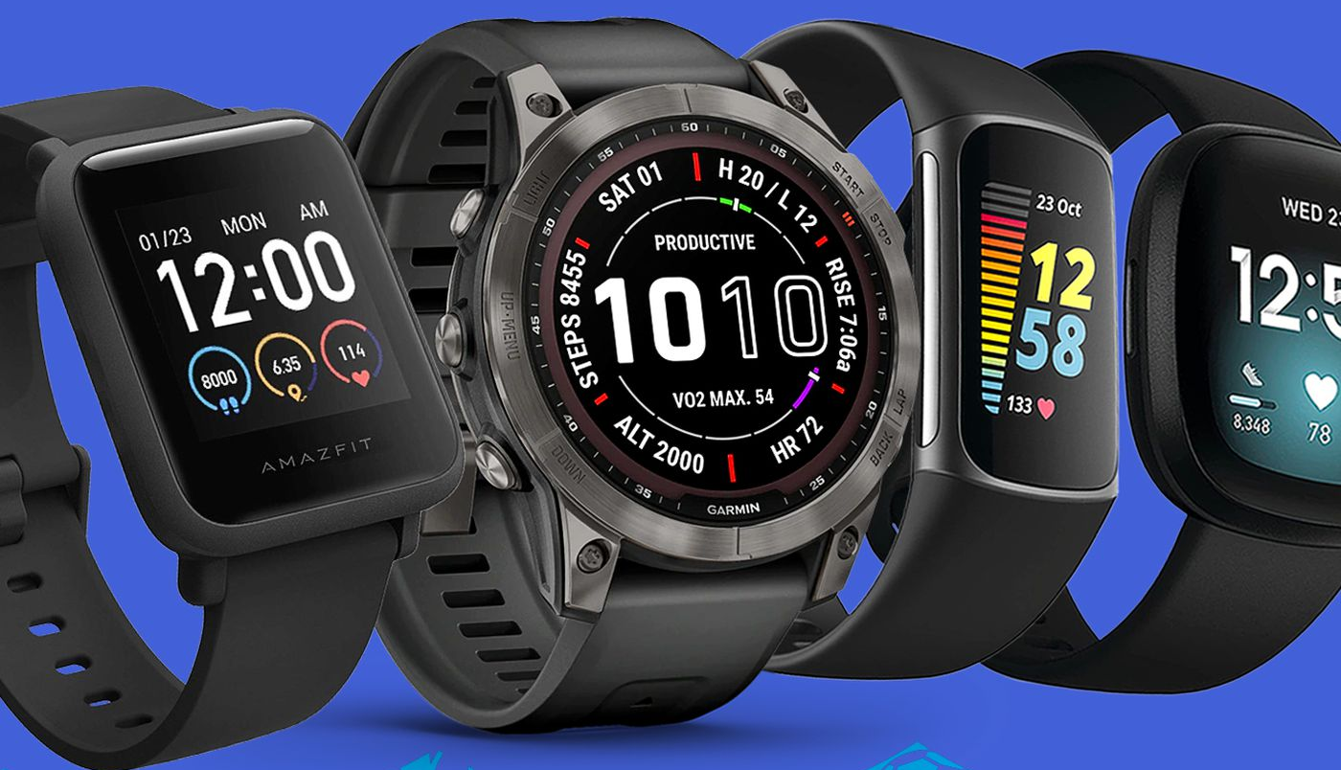
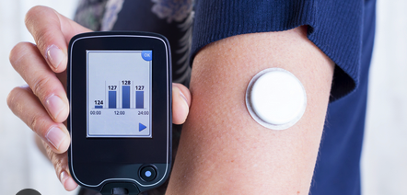
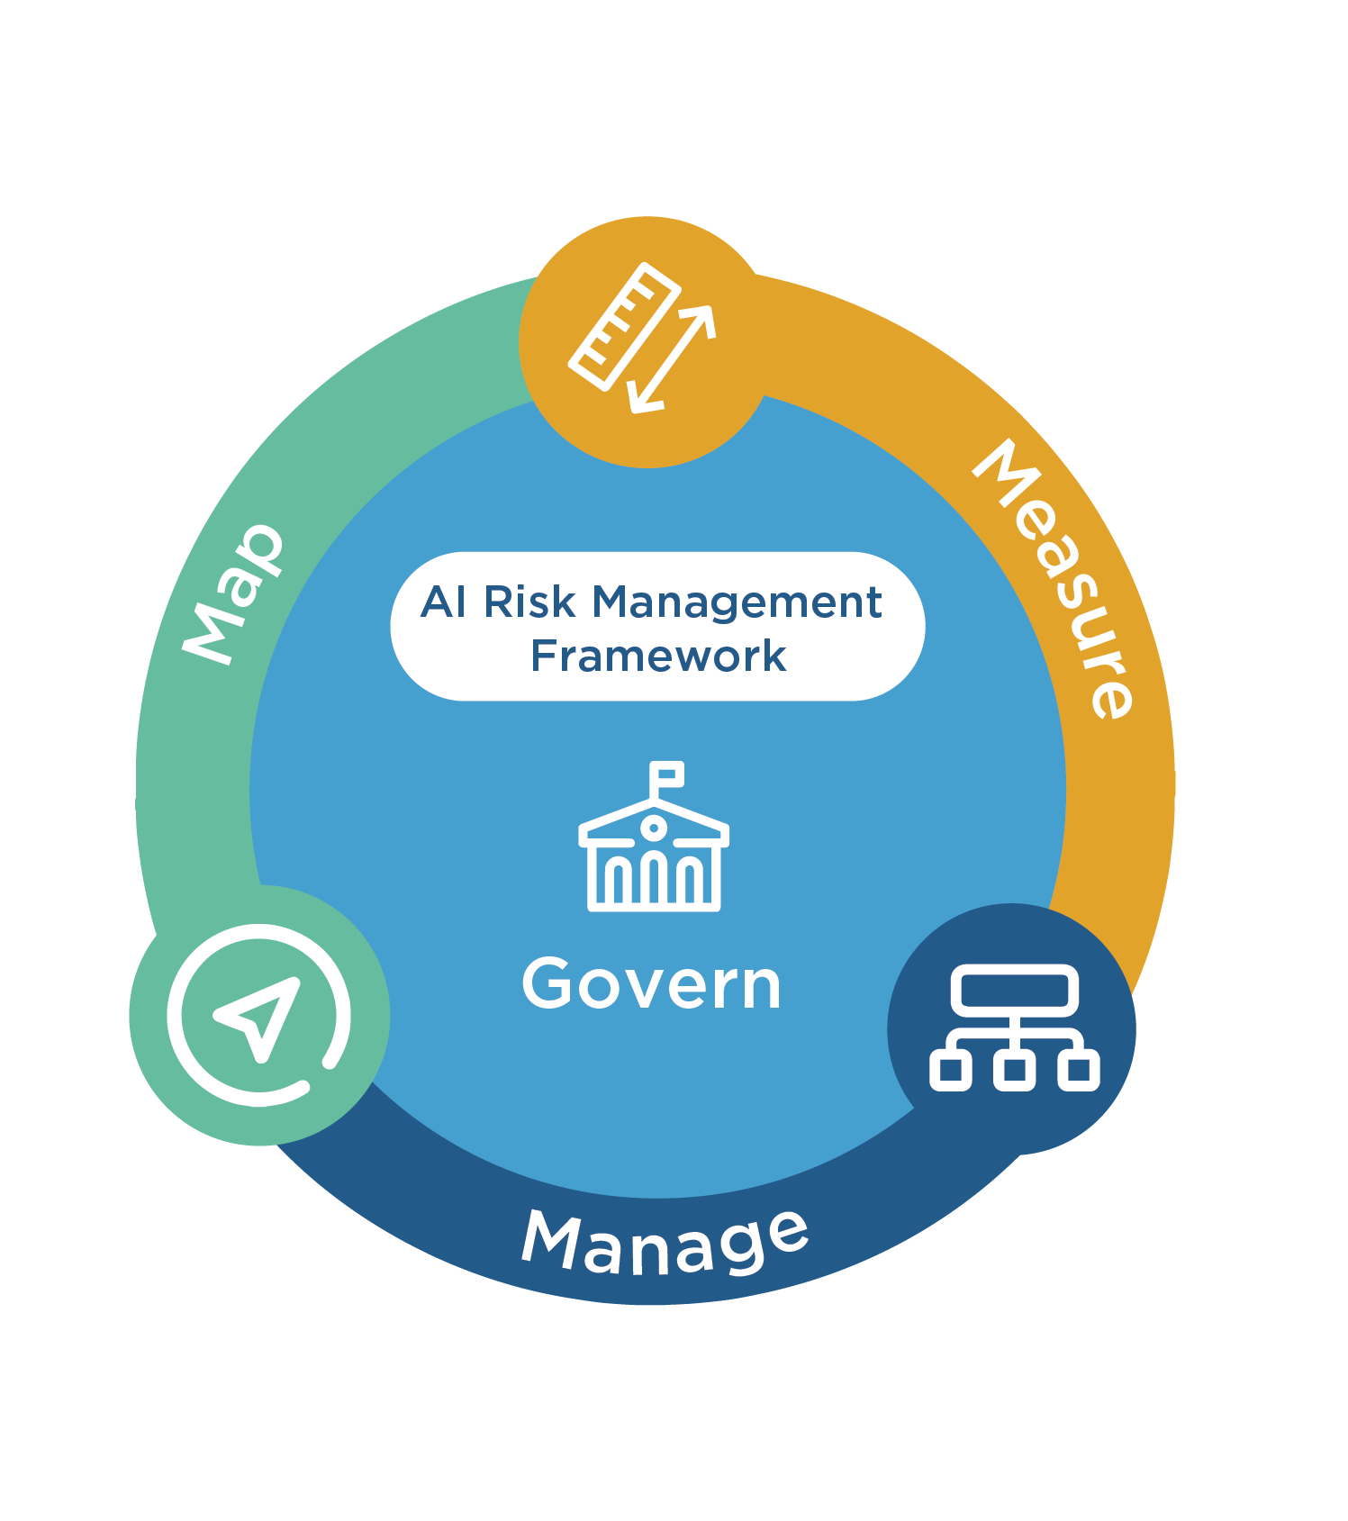
AI Ethics for Smart Health through Smart Watches Prof. Yolanda Gil
Description: This project will conduct a thorough study of the ethical issues in using AI systems in this domain, with recommendations of how AI systems for smart health should be designed with ethical considerations in mind.
Skills needed: Interest in AI ethics, healthcare and data science.
Students will learn: What kinds of health-related data can be captured through wearable devices, what kinds of analyses are possible, privacy and ethical aspects of personal applications for smart health.
OECD
NIST
USC DataFirst Fall 2023

